Slide 1


Lauren Trentham
Gina Guinn
Yuka Ito-Currin
Jerome Dixon
Dustin Chamberlin
Patient Flow Predictive Model

Slide 2


Slide 3
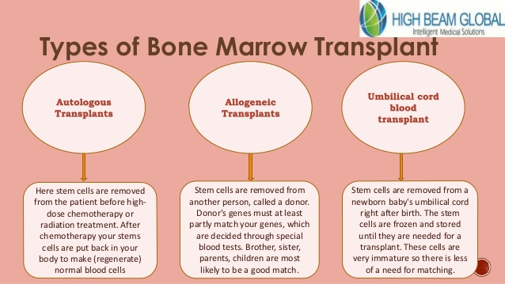

Slide 4
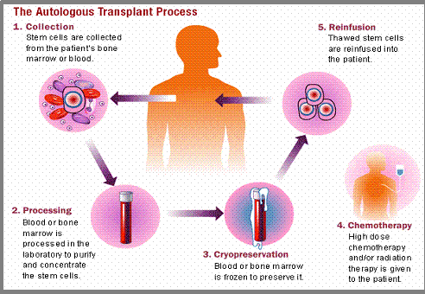

Slide 5
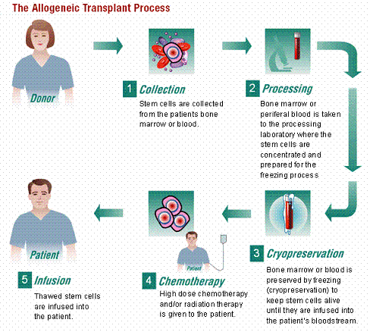

Slide 6
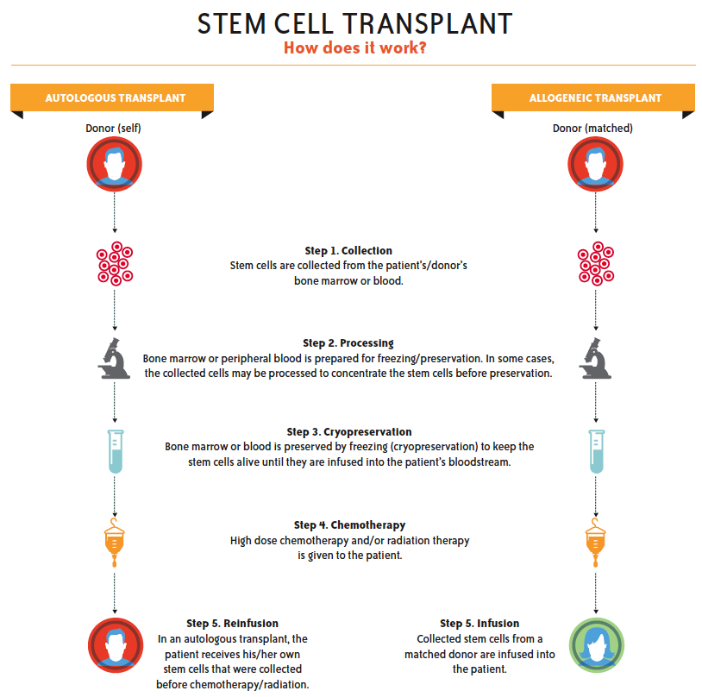

Slide 7
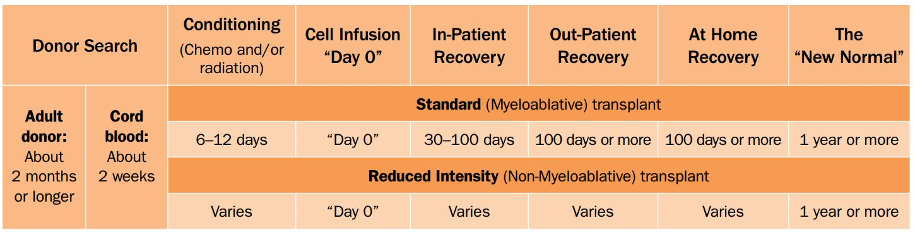

Slide 8
Project Goal:
Create a predictive model from historical data that will estimate patient volume through the various clinical phases of the Bone Marrow Transplant (BMT) process.
Data from 2010-2015 will be used to train the model.
Data from 2016-2017 will be used to test and validate model accuracy.

Slide 9
Project Outputs:
Dashboard that shows red, yellow or green representation of patient volume through each phase of the process
Estimate of quarterly and annual transplant volumes

Slide 10
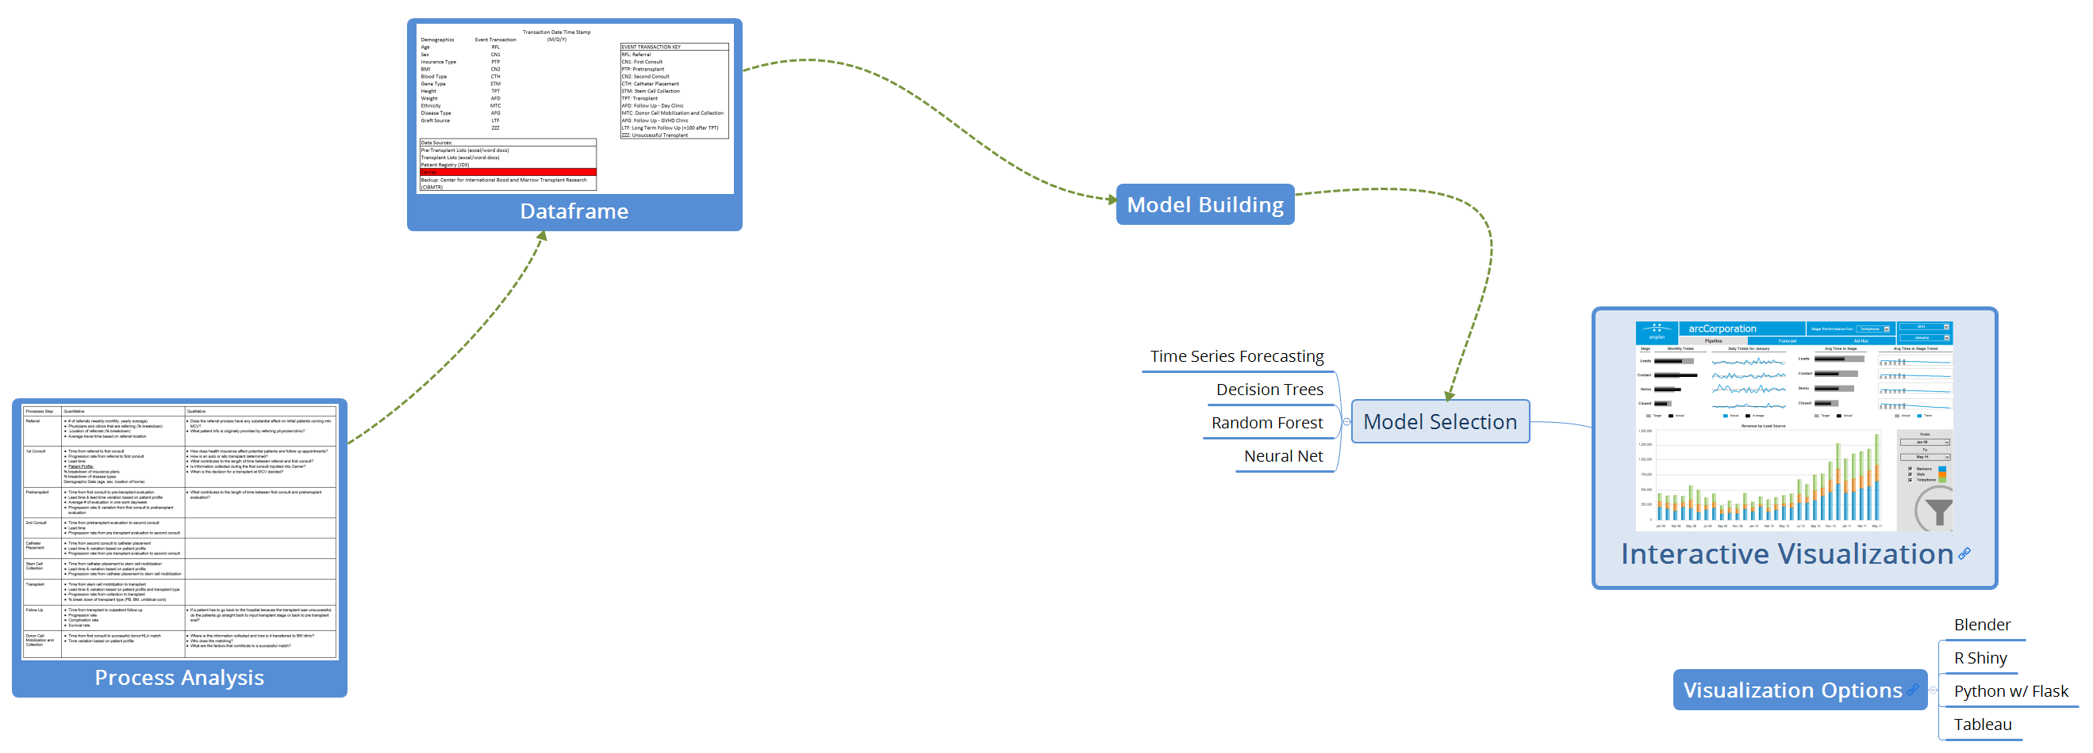
From Analysis to Insight

Slide 11
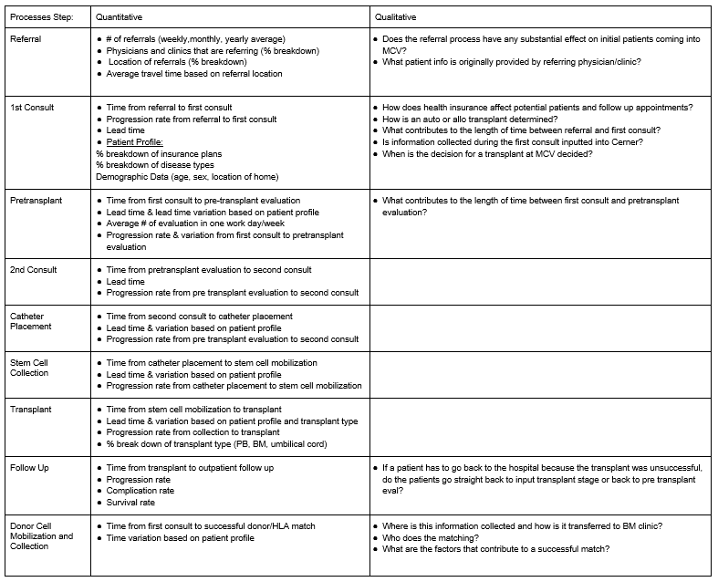
The Process

Slide 12
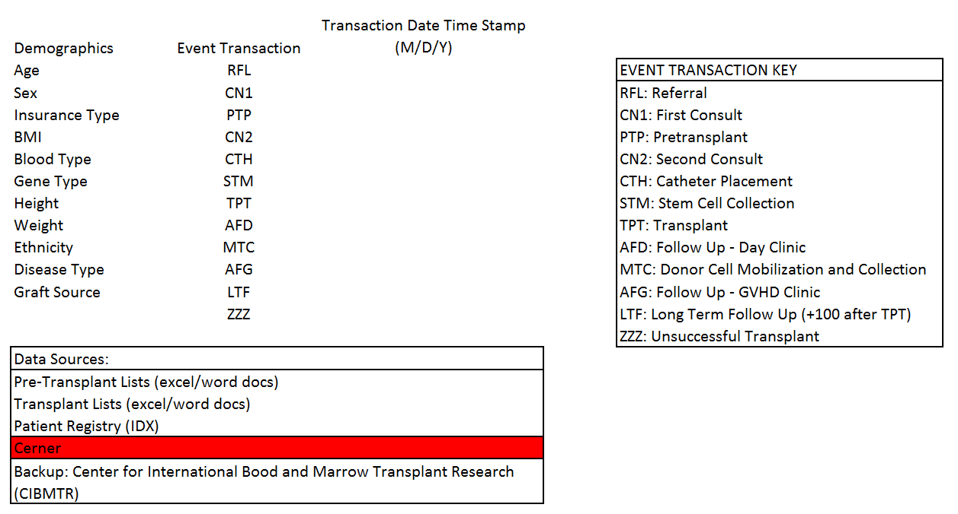
The Data

Slide 13
Next Steps:
Develop business rules for transactions and date of transaction by data source with retrieval method
Capture demographic data for each patient
Capture transaction data for each process
Join patient and process data via column vector
Perform analysis and choose best model

Slide 14
Questions/Comments

Slide 15
Backup Slides
Pub Med:
Data Visualizations

Slide 16
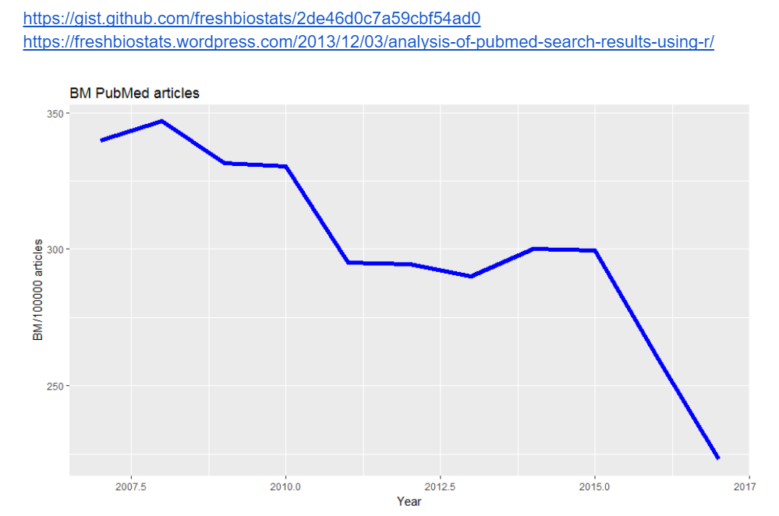

Slide 17
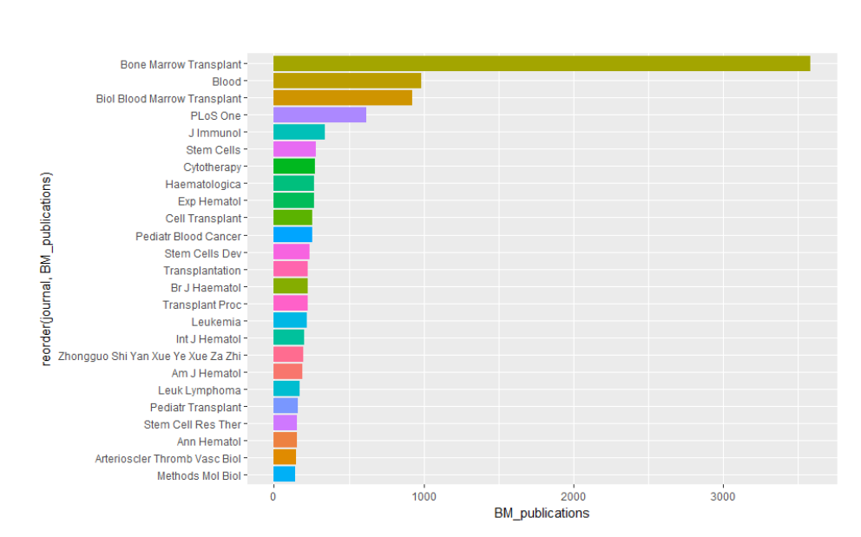

Slide 18
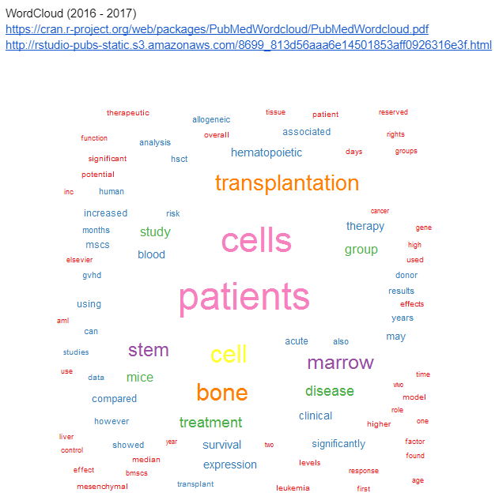

Slide 19
